Slide 1
What is Post Traumatic Stress Disorder?
Roger Baker
Professor of Clinical Psychology
Bournemouth University
November 2013

Slide 2
What is a trauma?

Slide 3


Slide 4
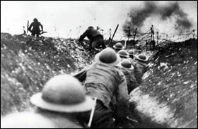

Slide 5
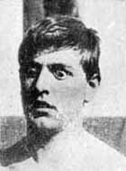

Slide 6
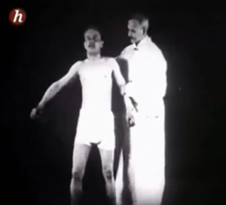

Slide 7
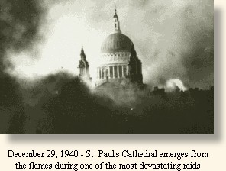

Slide 8


Slide 9
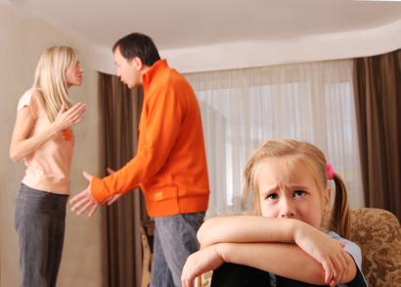

Slide 10
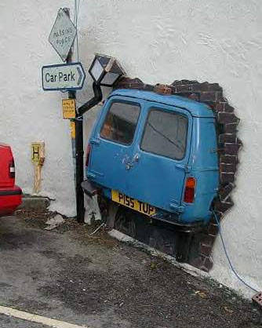

Slide 11
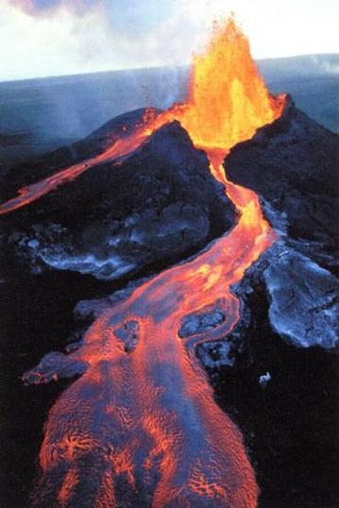

Slide 12
What is a trauma?
Personal accidents e.g. car crash
Large scale accidents e.g. King’s Cross station fire
Intentional disasters e.g. 9/11 attacks
National disaster e.g. experiencing a tsunami
Personality inflicted crimes e.g. mugging
Sexual abuse e.g. in childhood, marital abuse or rape
Illness-related e.g. diagnosis of cancer
Wartime conflict e.g. war in Afghanistan
Long term or repeated trauma e.g. genocide in Sudan
Notes:
Pause; Think “ In my lifetime have I experienced a trauma?”

Slide 13
Personal reactions to a trauma

Slide 14


Slide 15


Slide 16
Why me?
Victims are forced to reconsider at least 3 assumptions about themselves and the world:
  That they are personally invulnerable; “It can’t happen to me”
  That the world is orderly and meaningful; “But it did happen and I no longer feel safe”
  That they are good and strong people; “What did I do to deserve this? It’s not fair”.

Slide 17

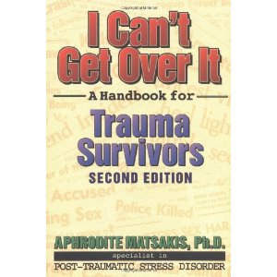

Man’s Search for Meaning’ by Viktor Frankl
‘I can’t get over it’ by Aphrodite Matsakis
‘A Grace Disguised’ by Jerry Sittser

Slide 18
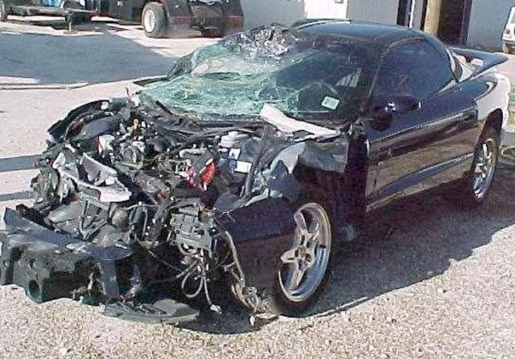

Slide 19
Why me?
The Aftermath of a Road Accident
I remember those first moments after the accident as if everything was happening in slow motion. They are frozen into my memory with a terrible vividness…In the hours that followed, the initial shock gave way to an unspeakable agony. I felt dizzy with grief’s vertigo, cut off from family and friends, tormented by the loss, nauseous with pain…I could not stop crying. I could not silence the deafening nose of crunching metal, screaming sirens, and wailing children. I could not rid my eyes of the vision of violence, of shattering glass and shattered bodies. All I wanted was to be dead.

Slide 20
Prolonged trauma

Slide 21


Slide 22
Experiences of a Concentration Camp Survivor
Three phases of the inmate’s mental reactions to camp life became apparent; the symptom that characterises the first phase is shock. The illusions some of still had were destroyed one by one, and then, quite unexpectedly, most of us were overcome by a grim sense of humour. Apart from that , another sensation seized us: curiosity. Cold curiosity predominated even in Auschwitz, somehow detaching the mind from its surroundings. At that time one cultivated this state of mind as a means of protection

Slide 23
These reactions began to change in a few days. The prisoner passed from the first to the second stage; the phase of relative apathy, in which he achieved a kind of emotional death. By means of this insensibility the prisoner soon surrounded himself with a very necessary protective shell. Reality dimmed, and all efforts and emotions were centred on one task; preserving one’s own life and that of the other fellow.

Slide 24


Slide 25
In the third phase – the release of the prisoner – everything appeared unreal, as in a dream. We had lost the ability to feel and had to relearn it slowly. Many days passed, until not only the tongue was loosened, but something within oneself as well; then feeling suddenly broke through the strange fetters which had restrained it……Apart from the moral deformity, there were two other fundamental experiences that threatened to damage the character of the liberated prisoner: bitterness and disillusionment.
Victor Frankl, ‘A Man’s Search for Meaning’

Slide 26
I pointed to the roll of paper in the inner pocket of my coat and said, “Look, this is the manuscript of a scientific book. I must keep it at all costs. It contains my life’s work”. The reaction showed me the plain truth and did what marked the first phase of my psychological reaction: I struck out my whole former life. The odds of surviving the camp were no more than 1 in 28. It did not seem possible that the manuscript would ever be rescued. I had to undergo and overcome the loss of my mental child and now it seemed that nothing and no one would survive me. So I found myself confronted with the question whether, under such circumstances, my life was ultimately void of any meaning.

Slide 27
I did not know that the answer was already in store for me. When I surrendered my own clothes I was given the worn-out rags of an inmate who had already been sent to the gas chambers on his arrival at Auschwitz station. Instead of the many pages of my manuscript I found in the pocket of the coat a single page torn out of the Hebrew prayer book, containing the most important Jewish prayer, Shema Yisrael. How should I have interpreted such a coincidence other than as a challenge to live my thoughts instead of merely putting them on paper? Victor Frankl

Slide 28


Slide 29

Diagnostic criteria for PTSD
The person has been exposed to a traumatic event in which both of the following were present:
The person experienced, witnessed or was confronted with an event or events that involved actual or threatened death or serious injury or a threat to the physical integrity of self or others
The person’s response involved intense fear, helplessness or horror
Duration of the disturbance is more than one month
The disturbance causes clinically significant distress or impairment in social, occupational or other important areas of functioning

Slide 30
….diagnostic criteria for PTSD
The traumatic event is persistently re-experienced in one (or more) of the following ways:
Recurrent and intrusive distressing recollections of the event,
including images, thoughts or perceptions
Recurrent distressing dreams of the event
Acting or feeling as if the traumatic event were recurring (includes a
sense of reliving the experience, illusions, hallucinations and
dissociative flashback episodes)
Intense psychological distress at exposure to internal or external
cues that symbolise or resemble an aspect of the traumatic event
Physiological reactivity on exposure to internal or external cues that
symbolize or resemble an aspect of the traumatic event

Slide 31
….diagnostic criteria for PTSD
Persistent avoidance of stimuli associated with the trauma and numbing of general responsiveness as indicated by three (or more) of the following:
Efforts to avoid thoughts, feelings or conversations associated with the trauma
Efforts to avoid activities, places or people that arouse
recollections of the trauma
Inability to recall an important aspect of the trauma

Slide 32
….diagnostic criteria for PTSD
Markedly diminished interest or participation in significant activities
Feeling of detachment or estrangement from others
Restricted range of affect (eg unable to have loving feelings)
Sense of a foreshortened future (eg does not expect to have a career, marriage, children or a normal life span)

Slide 33
….diagnostic criteria for PTSD
Persistent symptoms of increased arousal
(not present before the trauma) as indicated by two
(or more) of the following:
Difficulty falling or staying asleep
Irritability or outbursts of anger
Difficulty concentrating
Hypervigilance
Exaggerated startle response

Slide 34
Four psychological mechanisms
Mechanism 1: Re-experiencing the event

Slide 35


Slide 36
Four psychological mechanisms
Mechanism 1: Re-experiencing the event
Flashbacks ‘I suddenly see the face of the intruder’
Nightmares ‘In my dream the cancer had returned and I was on the operating table having both breasts removed. The surgeons were trying to cut deeper and deeper saying ‘we can’t get it all out’. My children stood around the operating table crying’
Sense of reliving the trauma, e.g. prisoners of war suddenly feeling they were back in captivity
Intense psychological distress to trigger stimuli, hearing squealing tyres brings back the distress of the accident.
Intense physiological distress to trigger stimuli, e.g. Chemo infusion, ‘it’s just a certain red... Even to think about that sort of red makes me feel... It brings back all the sick feeling and makes me feel a bit shaky’.

Slide 37
Four psychological mechanisms
Mechanism 2: Persistent increased arousal

Slide 38
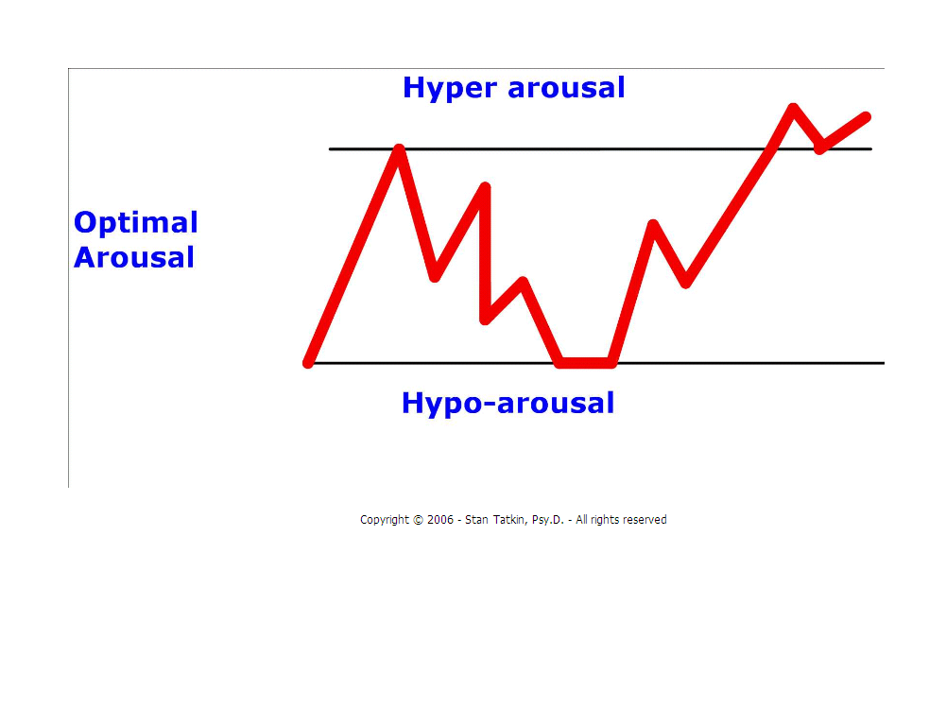

Slide 39
Four psychological mechanisms
Mechanism 2: Persistent increased arousal
Difficulty falling or staying asleep
Irritability, e.g. ‘my fuse is much shorter. John (her husband) will make a joke and I jump down his throat’
Difficulty concentrating
Hypervigilance
Exaggerated startle response

Slide 40
Four psychological mechanisms
Mechanism 3: Emotional numbing

Slide 41


Slide 42
Four psychological mechanisms
Mechanism 3: Emotional numbing
Lack of interest in important activities ‘I have lost in socialising and in material things. I don’t go shopping as much as and would rather stay at home where I feel safer’
Restricted ability to experience feelings ‘all feelings ceased to be, at least on the surface, because one could not exist and at the same time live with such feelings of abhorrence, disgust and terror’
Feeling of detachment or estrangement from others ‘My body feels much as if my head and body were separate. It’s almost as if I am out of the room. I can hear your questions but they feel like they are at a distance’

Slide 43
Four psychological mechanisms
Mechanism 4: refers to a style of handling emotions
Avoidance

Slide 44


Slide 45
Four psychological mechanisms
Mechanism 4: refers to a style of handling emotions
Avoidance
Avoiding thoughts, feelings or conversation associated with the trauma
Avoiding activities , places or people that arouse recollections of the trauma.

Slide 46
NICE recommends “Prolonged Exposure” for adults in a safe environment. (National Institute of Clinical Excellence (2005) Post Traumatic Stress Disorder (PTSD) : The management of PTSD in adults and children in primary and secondary care. Clinical Guidance 26. March 2005.)

Slide 47

Like behavioural exposure for obsessions and phobias, exposure for the PTSD sufferer means facing the memories of the trauma.

Slide 48
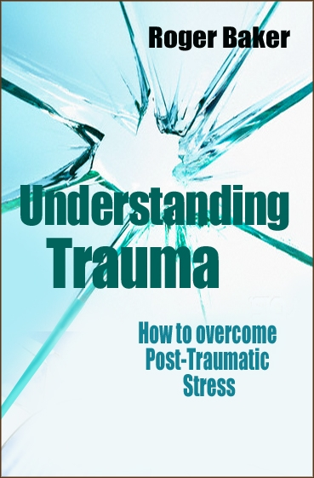
‘Emotional Processing Therapy’

Slide 49
The End

Slide 50
Susan
Post Traumatic Growth

Slide 51

Notes:
Read Susaqn’s account of her trauma

Slide 52
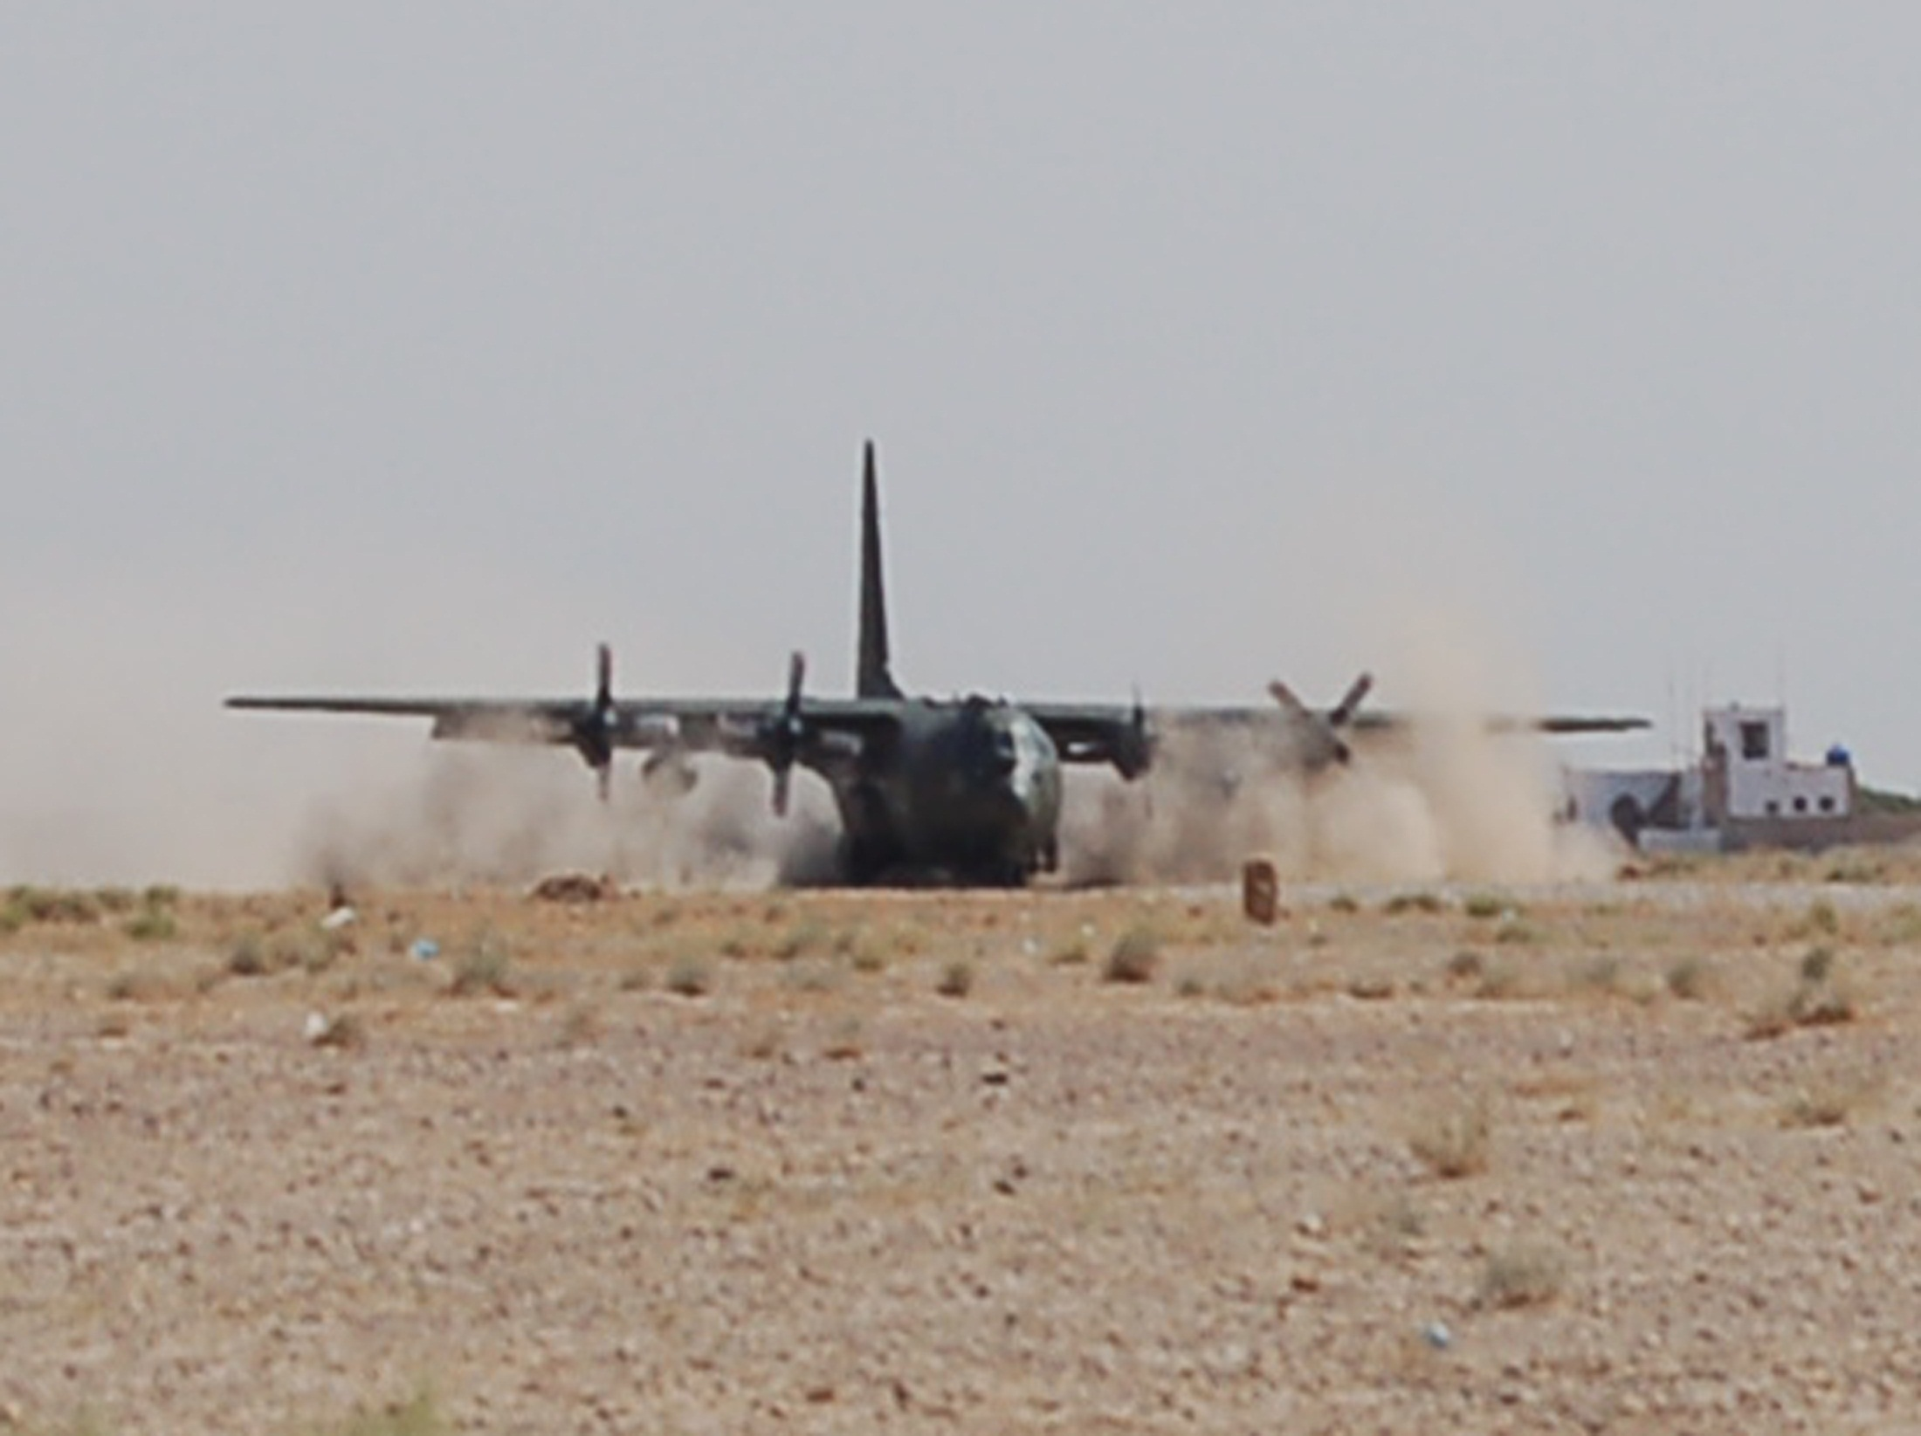
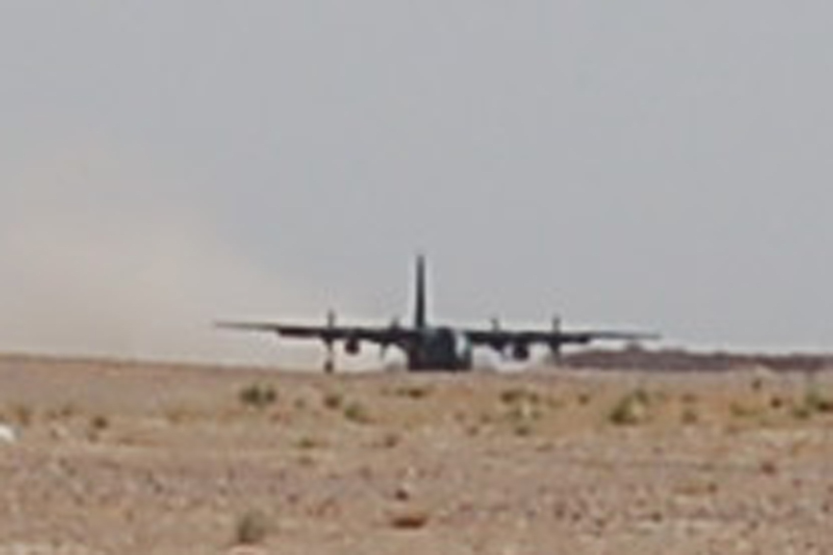

Slide 53
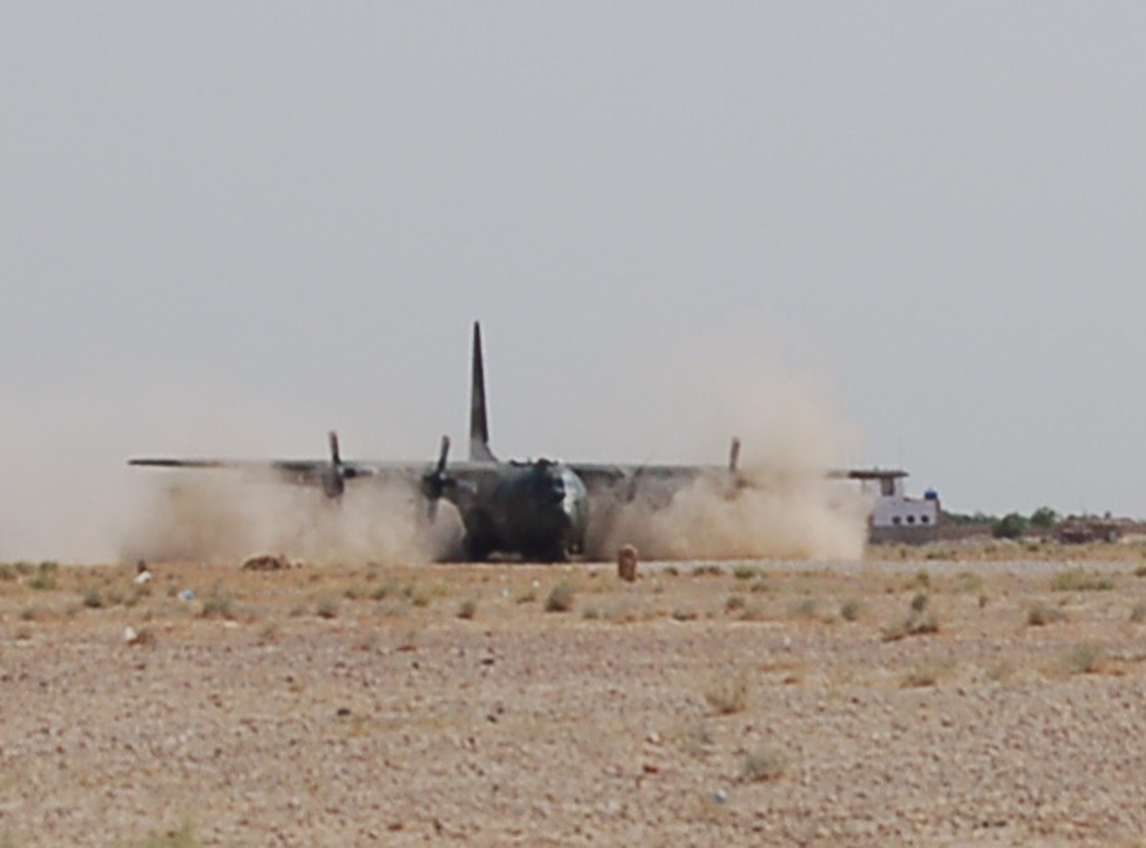

Slide 54
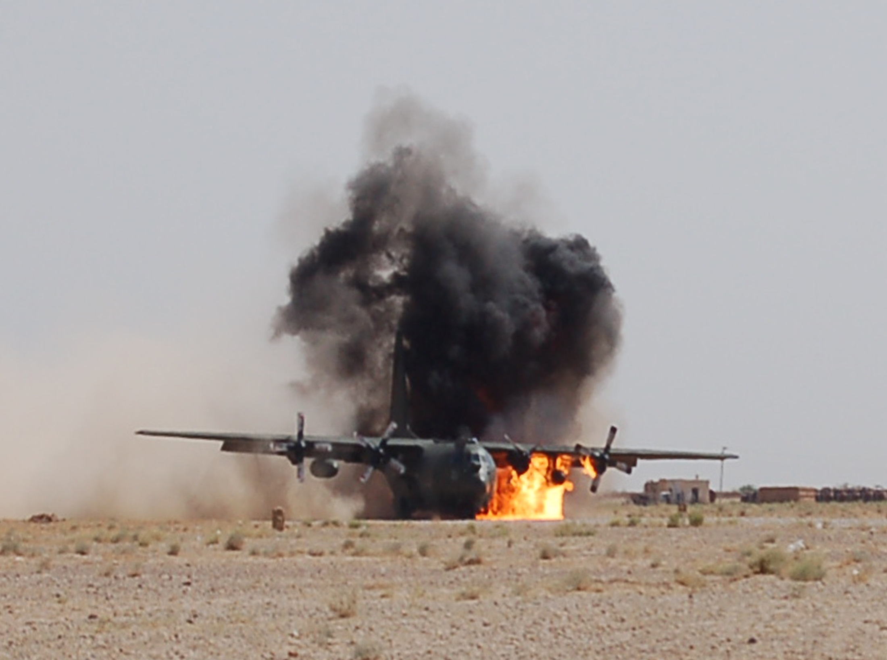

Slide 55
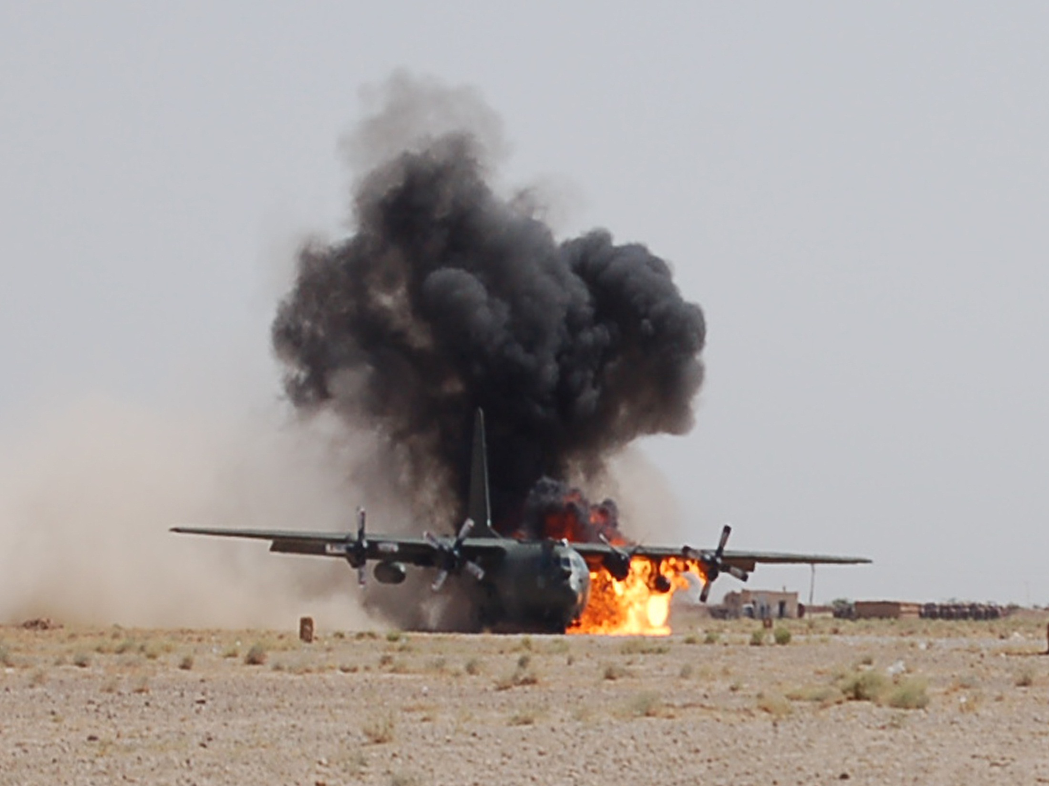

Slide 56
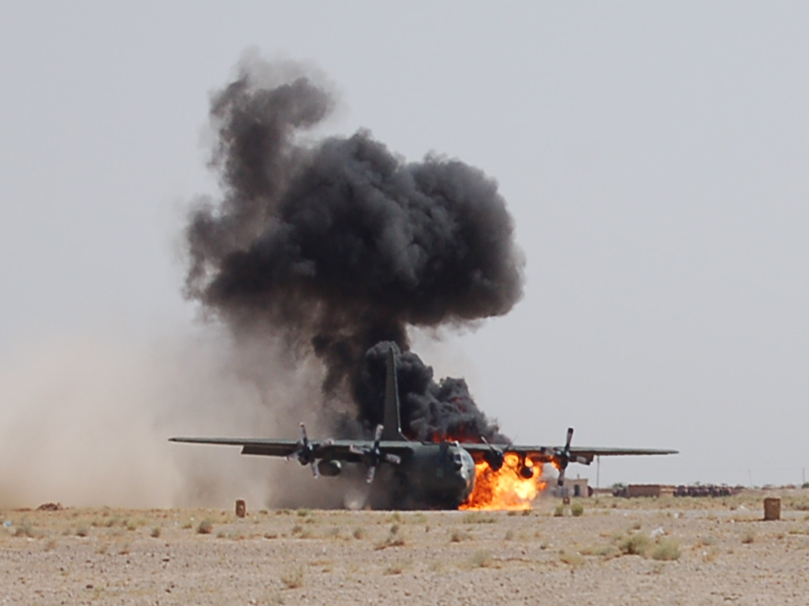

Slide 57
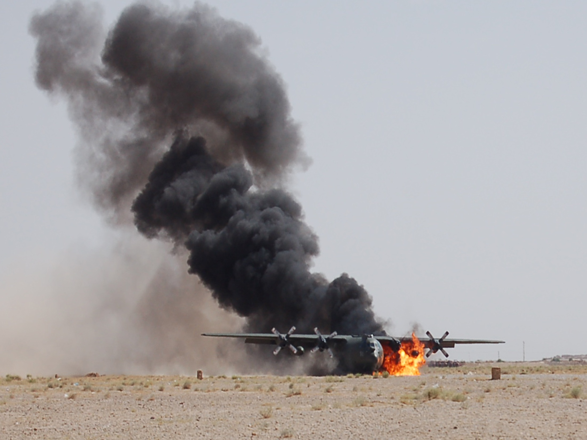

Slide 58
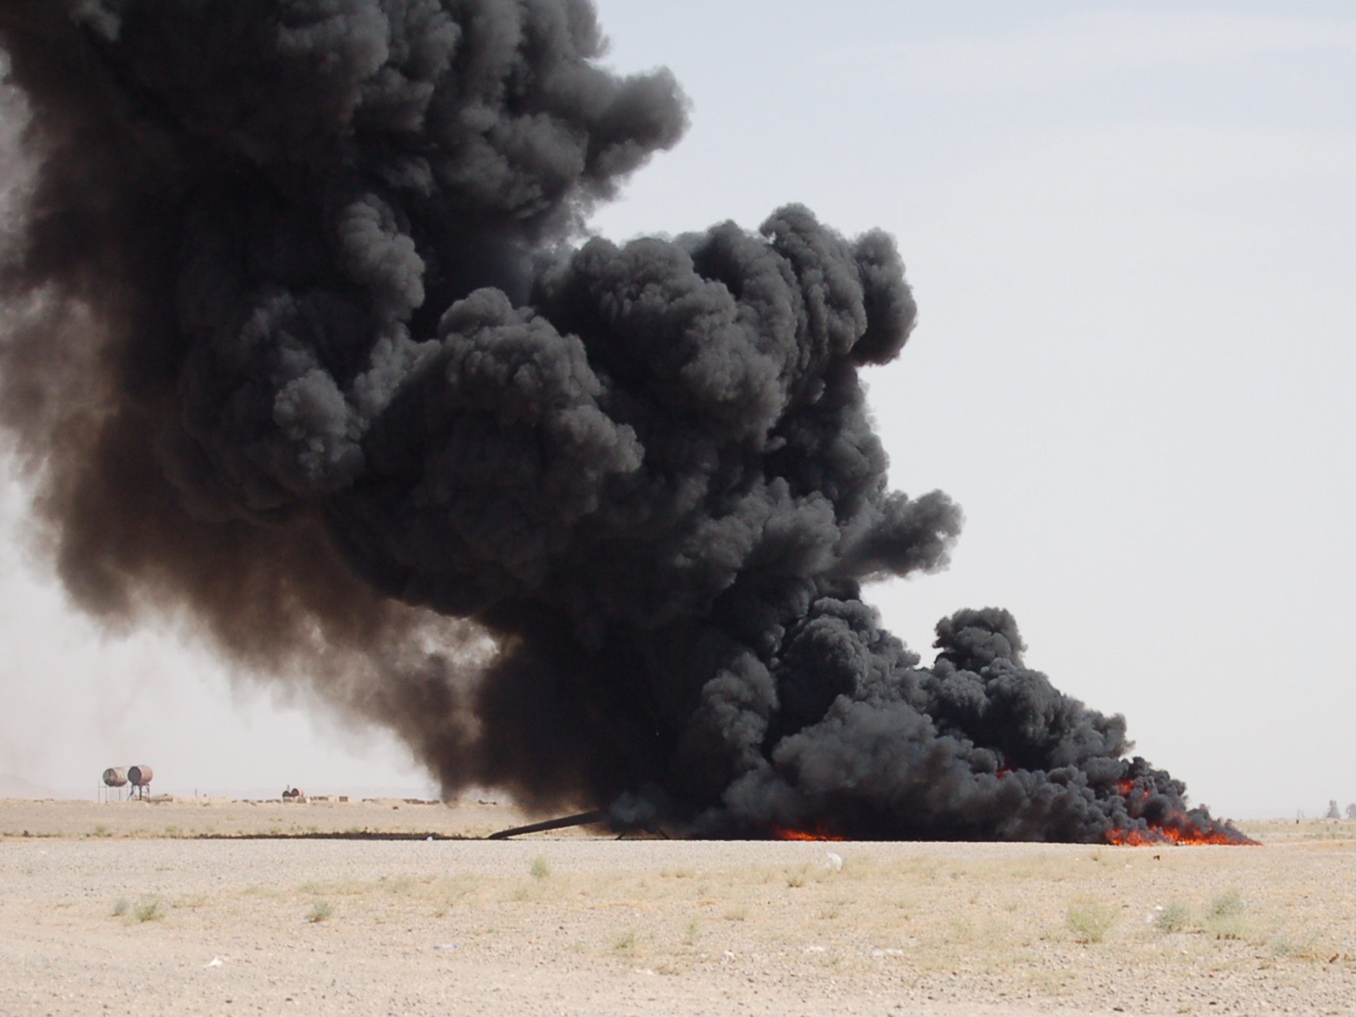

Slide 59
Susan’s healthy reaction to the trauma
The first night with the crew
Part of an excellent support group
Talking about the trauma to friends and family
Crying
Seeking out information about the crash
Talking to a trauma risk management staff member
Prior knowledge of PTSD
Getting back into an aircraft again
A wider philosophical perspective of her life
Generally aware of her own emotional life

Slide 61
Part 2
Emotional Processing therapy for PTSD

Slide 62
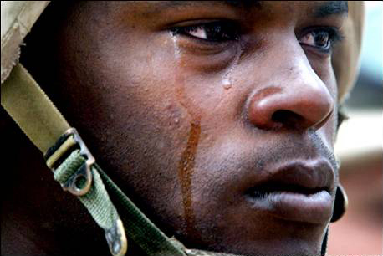

Slide 63
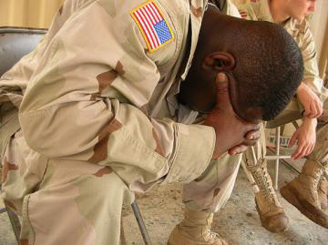

Slide 64
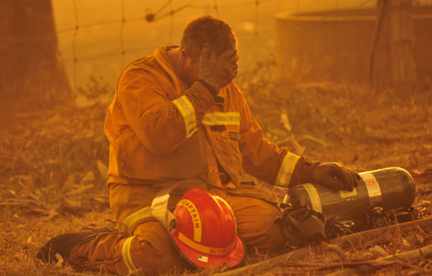

Slide 65
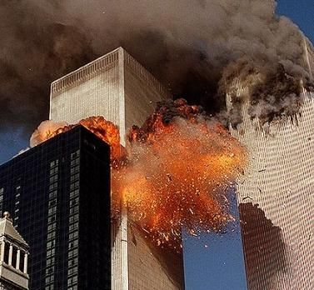

Slide 66
Post traumatic stress disorder
Therapy
C O N T R O L O F E M O T I O N S
input
experience
expression
EMOTIONAL EXPERIENCE
experienced as gestalt
awareness
labelling
linking
Of emotion
INPUT
EVENT
Appraisal
EMOTIONAL EXPRESSION
Of meaning of event
memory
of input
past memories
emotion schemas

Slide 67
Post traumatic stress disorder
C O N T R O L O F E M O T I O N S
input
experience
expression
Therapy
EMOTIONAL EXPERIENCE
experienced as gestalt
awareness
labelling
linking
Of emotion
INPUT
EVENT
Appraisal
EMOTIONAL EXPRESSION
Of meaning of event
memory
of input
past memories
emotion schemas
Successful emotional processing

Slide 68
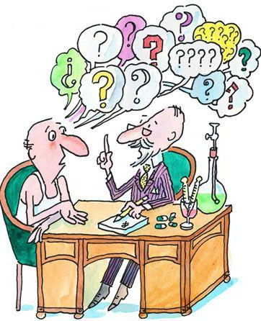
Problems with
Prolonged Exposure therapy:
Distressing
Difficult to keep going
Even trained therapists avoid using exposure
Patients drop out
Does not make sense to patients/contradicts their whole approach to trauma

Slide 69
‘Emotional Processing Therapy’
If exposure is primarily an emotional effect why not put it in a much more emotional context?

Slide 70
‘Emotional Processing Therapy’
Includes everything in prolonged exposure
but puts it into an emotional context which
makes more sense to patients

Slide 71
A simple explanation
The Problem; the traumatic memories have been buried and not properly emotionally processed
The Solution; facing the memories allows emotional processing to take place and ultimately removes their emotional power

Slide 72
‘Emotional Processing Therapy’

Slide 73
Before exposure sessions begin:
Explore the patients emotional processing style, using the Emotional Processing Scale
Their family’s style of emotional processing
How they have dealt with the trauma and previous life stresses
Ask what they would have to do to process the traumatic memories?

Slide 74
:
Explore the problems of suppressing emotions
Explore the implications of “opening a can of worms” and prepare for it
Share feelings generally with their partner, family
Read “Emotional Processing; healing through feeling”.
Throughout the whole therapy process discussions revolve around emotions

Slide 75

Emotional Processing Therapy for Post Traumatic Stress Disorder
Case example of Max
Seen by Roger Baker for therapy

Slide 76


Slide 77
Case example - Max
“When I was falling, for a split second I thought I would probably die. I thought after the accident I would be paralysed”. An ambulance arrived and the paramedics gave him morphine for the pain. “They said I was lucky – it could have been my back, head or neck”.

Slide 78
Nightmares
“The worst bit about the nightmares is waking up with a falling sensation and remembering the noise as I hit the concrete”.

Slide 79
Flashbacks
. He did report thinking about the accident every day, and that it “popped into my mind”. When I mentioned the word ‘flashbacks’, he immediately understood what I meant. He said they came about 4 times a day.

Slide 80
Avoidance
reminders on the TV;
he could not go back to the area in which the accident happened;
at first he could not speak to his workmates;
he stopped his regular games of snooker – initially because of his hand injury, but later “because I didn’t want to go out”;
“My partner talks to me, she’s great. I talk a bit, but don’t like to. She says it will help”.

Slide 81
Irritability and Hyperarousal
“If the children are playing and they slam a door, it frightens me. I jump out of my skin. I’m always telling them off. If we’re watching a DVD in the evening I get so agitated if the children talk in the middle of it that I stand up and switch it off. It’s not fair on them”.

Slide 82

Sessions 1
General background;childhood and adult
Usual emotional processing style and link with family style
Explanation of Emotional ProcessingTherapy
Homework – “Emotional Processing; healing through feeling”

Slide 83

Session 2
Discussion about emotions
Prepare for Therapy; likely impact on his family
Homework – think of the implications of opening up more fully

Slide 84

Session 3
“After the last session I’ve been thinking about it and wrote it down. I was down in the dumps thinking about it for a few days, but then I cheered up and stopped thinking about it. Later, when I read what I wrote it became clearer - the idea of letting it all out. I was quite relieved. I felt a big weight off my shoulders”.

Slide 85
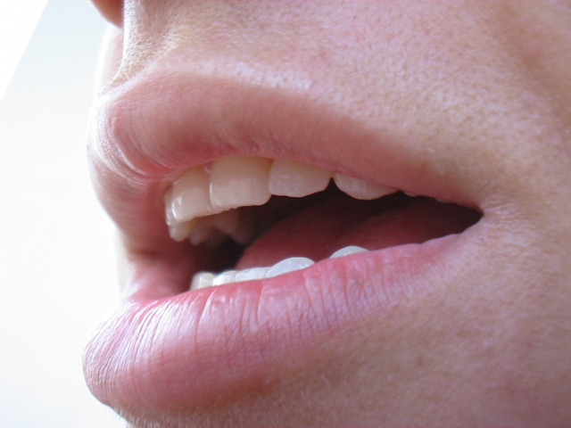
Session 4
Ascertain readiness to start
Detailed retelling of accident
“OK, I’d like you to take me through what happened, starting when you got up on the morning of the accident. Take me through everything in detail. Is that OK? Don’t hold back, and if you feel like crying, do. Showing your feelings is OK.”

Slide 86
Session 4
Key emotional moment
“After washing some windows I put my right foot back where I thought the balcony floor was and started to fall. I saw windows zoom past me. I’m falling. Will I die? What will be at the bottom? My heart was racing, I was sweating. Horror. I remember lying on the ground sweating, as if someone had hit me round the head with a plank. My ears were ringing and dull.”
He remembered seeing a finger sticking up unnaturally in an impossible position.

Slide 87

Session 5
Repeating the accident in detail
Involve kinesthetic memory
Recall the event silently in real time
Homework
“A memory can’t break an arm”

Slide 88
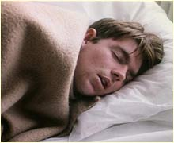
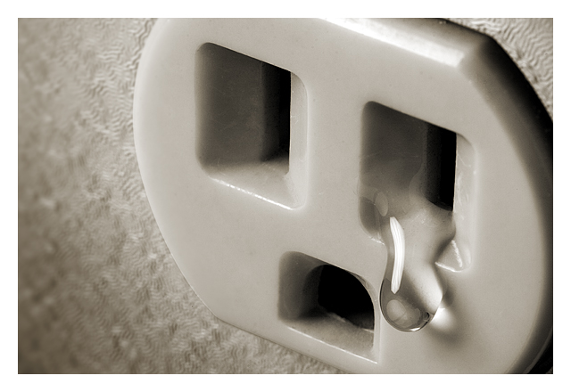
Session 5
. “I went home and felt relieved and emotional – I still do. I was remembering more in my sleep, but not actually waking up as in nightmares. According to my partner I wasn’t jumping about this week”.

Slide 89
Session 5
“I feel the tears at the back of my eyes that want to flood out. They have flooded out - on Saturday evening. Elsa comforted me. It was like a burden on my and now I’ve actually talked about it I feel better”.

Slide 90
Session 6
Repeat accident concentrating on what happened in hospital
Deal with secondary reactions such as anger, lack of forgiveness, guilt, shame

Slide 91

Session 6
Homework report
Three days after he had previously seen me, he wrote about the sequel to the fall which “started flowing out and I didn’t feel emotional”.
He said he had done this together with his partner. Over three sittings in 3 nights they had worked on it together. He had talked with her freely, in a detail he had never done before. She said “Well done” after he had finished.

Slide 92
Sessions 7 & 8
Spacing out the sessions to leave longer time intervals
Repeat those sections of the accident where emotional issues still existed

Slide 93
Session 8
In the last session I asked him about thoughts and flashbacks of his injuries.
“If I sit down and think I can remember bits. Before, it was always on my mind. Before, I couldn’t get it out of my mind, now I have to think about it in order to get it on my mind.”

Slide 94
Session 8
DAVIDSON TRAUMA SCALE
At assessment At therapy session 8
Intrusion Score 29 0
Avoidance/Numbing Score 18 0
Hyperarousal Score 28 1
Total Score 75 1
extremely high probability of a extremely low probability of a
diagnosis of PTSD) diagnosis of PTSD

Slide 95

When exposure sessions start:
The patient understands why it is important to face emotional memories

Slide 96

It is part of a ‘lifestyle’ not just a nasty therapeutic procedure

Slide 97

It slots into common cultural beliefs about emotion

Slide 98

It makes the patient experience more real, intense and meaningful and can enhance the therapist-patient relationship

Slide 99

It normalises their experience

Slide 100

They have already practised a more open style of sharing feelings

Slide 101
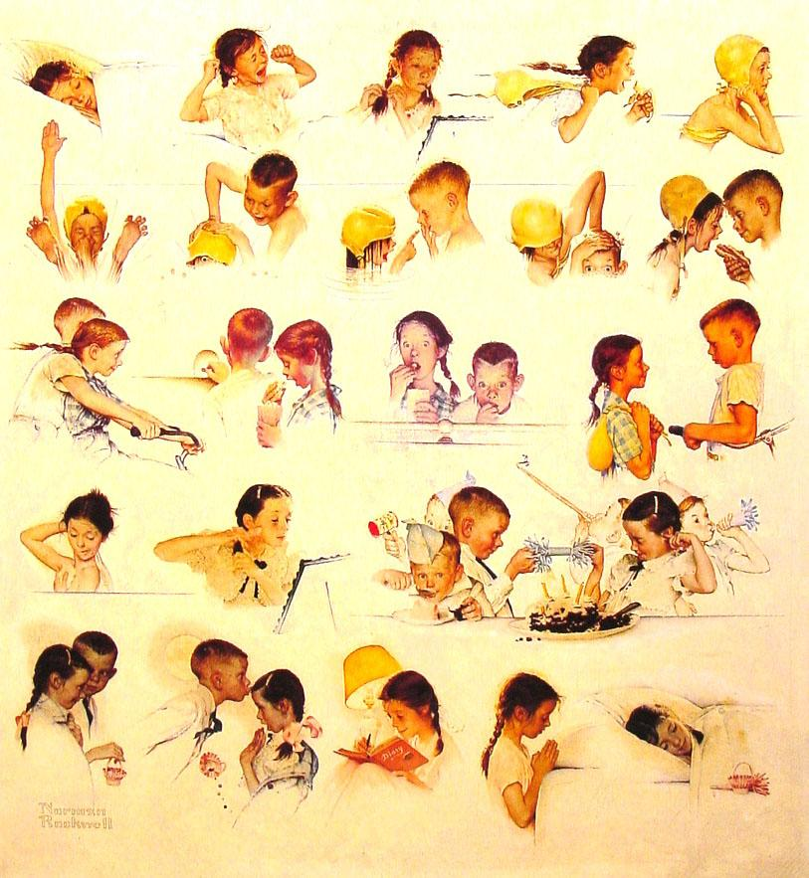
Encourages carry over to everyday life

Slide 102
How does Prolonged Exposure work?
Physiological habituation of anxiety responses
Invalidation of cognitive appraisals, e.g. ‘if I talk about the trauma my distress will never subside’.
Putting memories into words places a structure on emotions
The changed memory is stored superimposed on the old memory

Slide 103
What are the advantages of Emotional Processing Therapy?
Reframed in an emotion context
PTSD symptoms and Therapy are normalised and made more acceptable
Continuity with family and cultural upbringing
Links with emotions in everyday life
A lifestyle change as well as a therapy
Their changes in emotional processing style may help prevent future psychological problems
Emotional processing therapy for PTSD

Slide 104
“Understanding Trauma; how to overcome post traumatic stress” Roger Baker 2010
“knowing how to face trauma and minimise its worst ravages is a skill we can all benefit from”

