Slide 1
Emotional processing in patients with psychogenic non-epileptic seizures and the implications for treatment
Stephanie Howlett Sheffield Teaching Hospitals NHS Foundation Trust
Prof Markus Reuber Academic Neurology Unit, University of Sheffield
Barbora Novakova University of Sheffield
Isobel Williams University of Sheffield

Slide 2
Sheffield specialist neurology psychotherapy service
Established 2003
Located within Department of Neurology
Offers brief (< 20 sessions) psychotherapy to patients diagnosed with Functional Neurological Symptoms
Current establishment 6 x full or p/t psychotherapists + 1 team leader
Patients referred by consultant neurologists who keep patient on their caseload and review after psychotherapy

Slide 3
Outline
Psychogenic non-epileptic seizures (PNES) background information
Therapeutic approach
Study of emotional processing and PNES – baseline data
Case vignettes
Preliminary outcome data

Slide 4
Definition
“(Psychogenic) non-epileptic seizures superficially resemble epileptic seizures but are not associated with abnormal electrical activity in the brain. They are episodes of paroxysmal impairment of self-control associated with a range of motor, sensory, and mental manifestations, which represent an experiential or behavioural response to distress”¹
¹Reuber M and Mayor R , Recent progress in the understanding and treatment of nonepileptic seizures. Curr Opin Psychiatry 2012, 25:244-250

Slide 5
Psychogenic non-epileptic seizures
Also known as:
Dissociative seizures
Non epileptic attack disorder
Non-epileptic seizures
Functional seizures
Psychogenic seizures
Pseudo-seizures*
Hysterical seizures*
* The last two terms have been used historically and may still be encountered but are now considered derogatory and should not be used.

Slide 6
Aetiology
History of psychological trauma → current tendency to autonomic disregulation or dissociation
History of developmental trauma → attachment and interpersonal difficulties
Life threatening medical illness
Difficulties with emotional processing
Emotional avoidance
Lack of emotional awareness
Marked emotional disregulation
Current social factors, conflicts and pressures
Organic neurological deficits, e.g. head injuries or intellectual disability¹
¹Reuber M et al. Evidence of brain abnormality in patients with psychogenic non-epileptic seizures.

Slide 7
Augmented model of psychodynamic interpersonal processing for FNS¹
Based on Psychodynamic Interpersonal (PI) therapy¹ and adaptation to work with psychogenic somatic illness²
Augmented to work with different challenges presented by PNES³
Assumption that symptoms arise from/exacerbated by faulty patterns of emotional processing and interpersonal relationships, and trauma reactions arising from past experiences
¹Hobson, R.F. (1985) Forms of Feeling. London: Tavistock
²Creed, F. et al. (2003). The cost-effectiveness of psychotherapy and paroxetine for severe irritable bowel syndrome. Gastroenterolgy, 124, 303-317.
³Howlett S & Reuber M. (2009) An augmented model of brief psychodynamic interpersonal therapy for patients with non-epileptic seizures. Psychotherapy theory, Research, Practice, Training. 46(1), 125-138.

Slide 8
Key features
Patients encouraged to:
Develop more effective interpersonal and emotional processing patterns
Stay with feelings
Notice and understand somatic imprint of emotions
Staged therapy to treat trauma based on somatic trauma therapy models

Slide 9
PNES and emotional processing
PNES has been associated with difficulties in EP including:
Abnormalities in EP in relation to healthy controls, patients with epilepsy and heathy controls with a history of trauma.
high levels of alexithymia¹
Avoidance – including emotional avoidance²
¹ Myers, L et al. Prevalence of alexithymia in patients with psychogenic non-epileptic seizures and epileptic seizures and predictors in in psychogenic non-epileptic seizures. Epilepsy Behav 2013;26:153-7
² Dimaro, L.V. et al. Anxiety and avoidance in psychogenic nonepileptic seizures: The role of implicit and explicit anxiety. Epilepsy Behav 2014;33: 77-86

Slide 10
Emotion processing and PNES: a cross-sectional comparison of patients and healthy controls¹
To describe the EP styles of PNES patients(n=50) compared to healthy controls (n=224)
To explore associations of EP with other psychological measures and seizure frequency using the EPS-25
¹Novakova B, Howlett S, Baker R, Reuber R. Emotion Processing and Psychogenic Non-epileptic Seizures: a cross-sectional comparison of patients and healthy controls. Seizure 2015 Jul;29:4-10

Slide 11
Study of Emotional Processing and PNES
Measures administered to patients immediately before starting psychotherapy
EPS-25 Emotional processing
CORE-10 Psychological distress
SF-36 Health related quality of life
PHQ-15 Physical symptoms
BIPQ Illness perceptions
Seizure frequency – self-reported

Slide 12
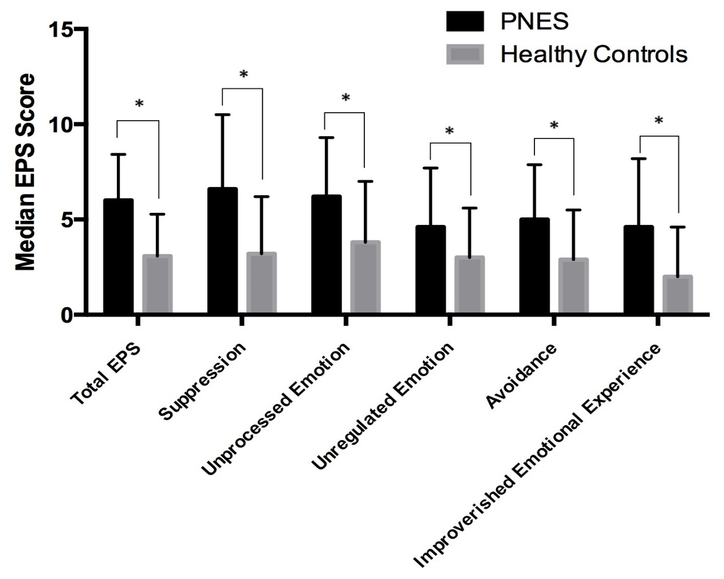
EP in PNES patients vs healthy controls
PNES patients
224 Healthy Controls
Mann-Whitney U test demonstrated significant differences in:
Total EPS
All EPS sub-scores

Slide 13
EP and seizure frequency
Median EPS scores in the different seizure frequency categories
Kruskal-Wallis test.
 | Seizure Category |  |  | P-values
 | More than 1 seizure/month but less than 1 seizure/week M (IQR) | More than 1 seizure/week but less than 1 seizure/day M (IQR) | More than 1 seizure/day but less than 1 seizure/hour M (IQR)
N | 15 | 15 | 12
Suppression | 7.2 (3.00) | 5.80 (6.60) | 7.30 (2.70) | n.s.
Unprocessed Emotion | 6.4 (2.20) | 5.00 (6.80) | 6.70 (2.35) | n.s.
Unregulated Emotion | 5.60 (2.60) | 4.40 (5.00) | 3.80 (1.45) | .049
Avoidance | 6.40 (3.40) | 4.80 (3.40) | 6.20 (2.25) | n.s.
Impoverished Emotional Experience | 5.00 (3.00) | 3.80 (5.40) | 5.20 (3.40) | n.s.
Total EPS | 6.12 (2.16) | 4.32 (5.70) | 6.20 (1.91) | n.s.
Note. M = median, IQR = interquartile range.

Slide 14
Total EPS scores and other measures
Correlations between the total EPS score and the PHQ-15, CORE-10, BIPQ, and the MHS and PHS summary sub-scales of the SF-36.
 | EPS | PHQ-15 | CORE-10 | BIPQ | SF-36 MHS | SF-36 PHS
EPS
PHQ-15 | .473*
CORE-10 | .723* | .591*
BIPQ | .475* | .582* | .723*
SF-36 MHS | -.702* | -.478* | -.809* | -.697*
SF-36 PHS | -0.088 | -.476* | -0.085 | -.442* | 0.031
NB * Correlation is significant at the 0.01 level.

Slide 15
Conclusions
PNES patients show clear deficits in all aspects of emotional processing compared to healthy controls
Impaired EP in patients with PNES correlates with
Psychological distress
A more threatening view of their symptoms
A greater number and severity of other physical symptoms
Reduced mental health functioning.
No clear link found with
Seizure frequency
Physical functioning

Slide 16
Patients with very low EPS scores
Lowest 10% on EPS scores:
Scores indicate no difficulties with EP
Clinical impressions
Emotionally flat and inaccessible
Difficult to engage in psychotherapy
N = 3, had frequent accidents affecting mobility and periods of hospitalisation as children
N=3, wheelchair bound, life of disability and dependence
Preliminary outcome data:
Got ‘worse’ on EPS, CORE-10, MHS. Is worse really better?
Got better on PHQ 15, Illness perceptions, slightly better on PHS

Slide 17
Outcome data for all FNS¹
 |  | Median (IQR)
 | N | Pre-intervention | Post-intervention | P value
EPS-25 total | 44 | 5.40 (3.35) | 4.64 (3.44) | .034*
EPS-25 subscales
Suppression | 44 | 6.00 (4.10) | 4.90 (4.10) | .058
Unprocessed emotion | 44 | 6.20 (4.80) | 5.00 (4.85) | .016*
Unregulated emotion | 44 | 4.40 (3.80) | 4.10 (3.85) | .321
Avoidance | 44 | 5.20 (3.49) | 4.90 (3.35) | .143
Impoverished emotional experience | 44 | 4.50 (4.30) | 3.60 (3.80) | .050*
SF36
Physical health summary score | 39 | 32.87 (19.10) | 35.69 (18.80) | .180
Mental health summary score | 39 | 39.31(12.89) | 39.93 (18.00) | .076
Other clinical symptomology scales |  | Mean (SD)
CORE-10 | 43 | 19.19 (9.39) | 17.05 (10.43) | .130
BIPQ | 35 | 55.51 (11.84) | 48.83 (15.79) | .012*
PHQ-15 | 37 | 14.05 (5.35) | 12.14 (6.32) | .026*
*=p≤.05 (two-tailed). CORE-10 = Core Outcome in Routine Evaluation-10, BIPQ= Brief Illness Perceptions Questionnaire, PHQ-15= Patient Health Questionnaire- 15
¹ Williams, I. Unpublished data for PhD thesis.

Slide 18
Thank you

