Slide 1
Treating Post Traumatic Stress in cancer survivors
Body and Mind – Making the Link
Salisbury
Roger Baker, Professor of Clinical Psychology, Bournemouth University
Lin Purandare, Cancer Nurse Consultant
Tamas Hickish, Consultant Oncologist,
Royal Bournemouth & Christchurch Hospitals NHS Trust
February 2011

Slide 2
Describe treatment of PTSD in cancer survivors
Describe a new type of therapy for PTSD - Emotional Processing Therapy,

Slide 3

The accidental birth of the Bournemouth PTSD Clinic for Cancer survivors

Slide 4
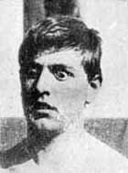

Slide 5
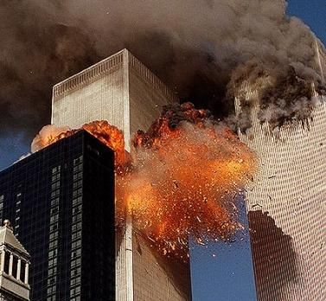

Slide 6

What is traumatic about Cancer?
The big ‘C’ – first detection

Slide 7

What is traumatic about Cancer?
Tests

Slide 8
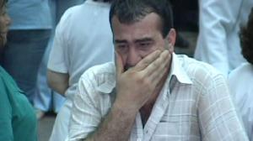
What is traumatic about Cancer?
Diagnosis

Slide 9
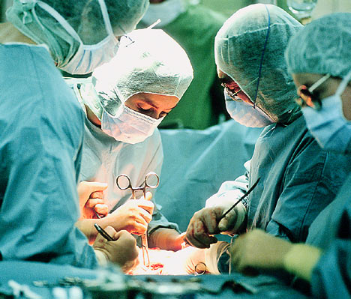
What is traumatic about Cancer?
Surgery

Slide 10
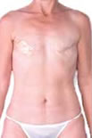
What is traumatic about Cancer?
Loss of breast

Slide 11
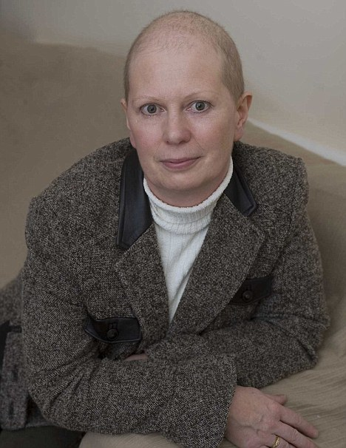
What is traumatic about Cancer?
Loss of hair

Slide 12
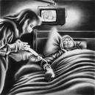
What is traumatic about Cancer?
Chemotherapy

Slide 13
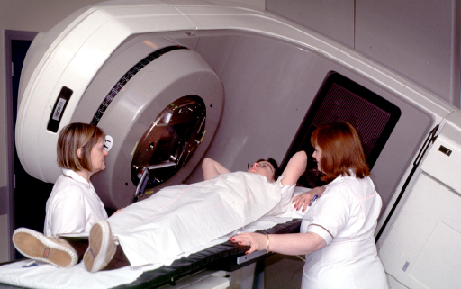
What is traumatic about Cancer?
Radiotherapy

Slide 14
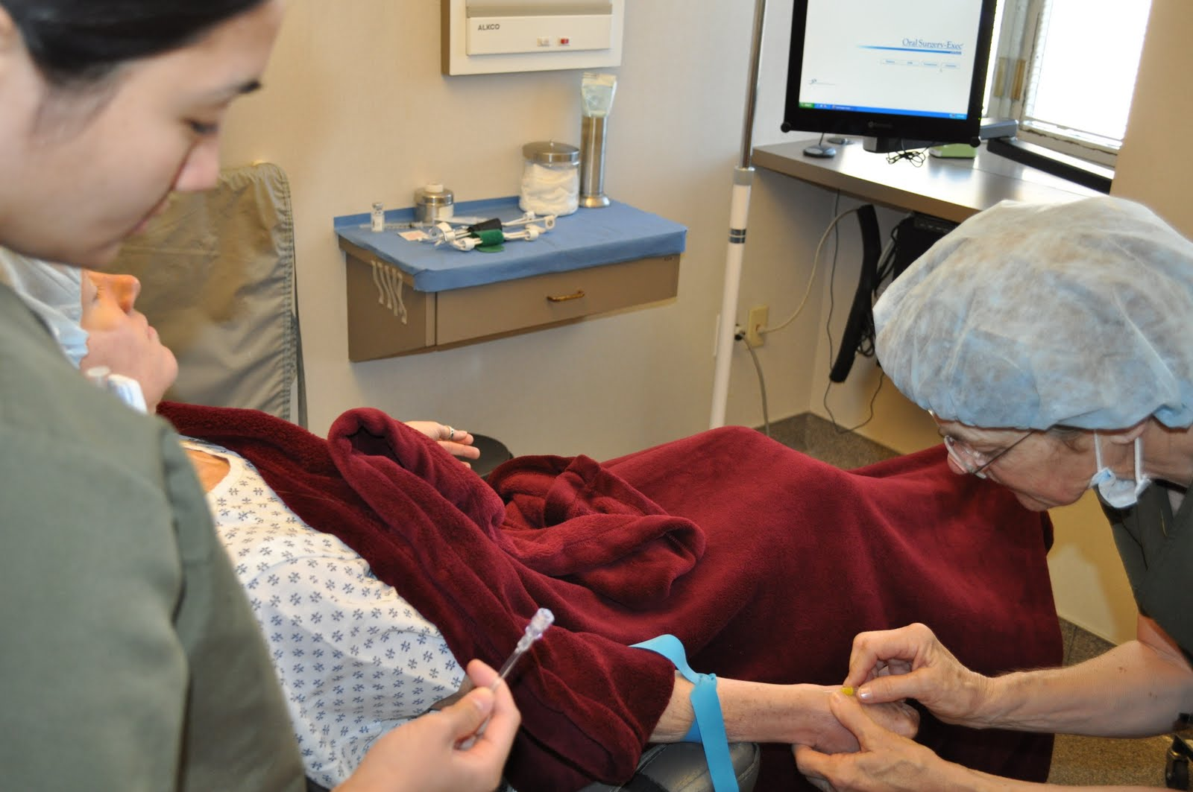
What is traumatic about Cancer?
Complications of therapy

Slide 15



Is Post Traumatic Stress Disorder an illness with a set of symptoms?
The PTSD menu has 17 symptoms

Slide 16
Four psychological mechanisms
Mechanism 1: Re-experiencing the event
Flashbacks ‘I suddenly see the face of the intruder’
Nightmares ‘In my dream the cancer had returned and I was on the operating table having both breasts removed. The surgeons were trying to cut deeper and deeper saying ‘we can’t get it all out’. My children stood around the operating table crying’
Sense of reliving the trauma, e.g. prisoners of war suddenly feeling they were back in captivity
Intense psychological distress to trigger stimuli, hearing squealing tyres brings back the distress of the accident.
Intense physiological distress to trigger stimuli, e.g. Chemo infusion, ‘it’s just a certain red... Even to think about that sort of red makes me feel... It brings back all the sick feeling and makes me feel a bit shaky’.

Slide 17
Four psychological mechanisms
Mechanism 2: Persistent increased arousal
Difficulty falling or staying asleep
Irritability, e.g. ‘my fuse is much shorter. John (her husband) will make a joke and I jump down his throat’
Difficulty concentrating
Hypervigilance
Exaggerated startle response

Slide 18
Four psychological mechanisms
Mechanism 3: Emotional numbing
Lack of interest in important activities ‘I have lost in socialising and in material things. I don’t go shopping as much as and would rather stay at home where I feel safer’
Restricted ability to experience feelings ‘all feelings ceased to be, at least on the surface, because one could not exist and at the same time live with such feelings of abhorrence, disgust and terror’
Feeling of detachment or estrangement from others ‘My body feels much as if my head and body were separate. It’s almost as if I am out of the room. I can hear your questions but they feel like they are at a distance’

Slide 19
Four psychological mechanisms
Mechanism 4: refers to a style of handling emotions
Avoidance
Avoiding thoughts, feelings or conversation associated with the trauma
Avoiding activities , places or people that arouse recollections of the trauma.

Slide 20
An avoidant style of handling emotions
Avoidance is not so much a symptom of PTSD but an emotional processing style that contributes to the development of PTSD

Slide 21
NICE recommends “Prolonged Exposure” for adults in a safe environment. (National Institute of Clinical Excellence (2005) Post Traumatic Stress Disorder (PTSD) : The management of PTSD in adults and children in primary and secondary care. Clinical Guidance 26. March 2005.)

Slide 22

Like behavioural exposure for obsessions and phobias, exposure for the PTSD sufferer means facing the memories of the trauma.

Slide 23
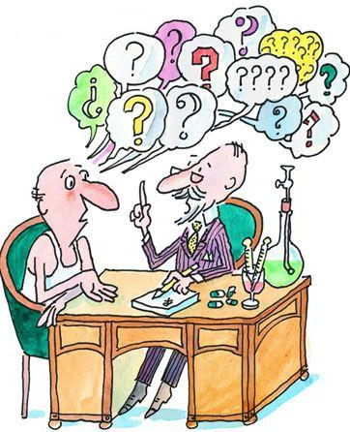
Problems with
Prolonged Exposure therapy:
Distressing
Difficult to keep going
Even trained therapists avoid using exposure
Patients drop out
Does not make sense to patients/contradicts their whole approach to trauma

Slide 24
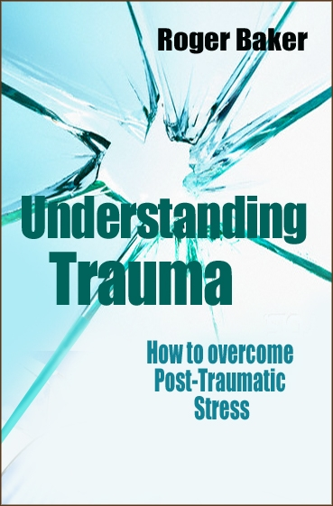
‘Emotional Processing Therapy’

Slide 25
‘Emotional Processing Therapy’
Includes everything in prolonged exposure
but puts it into an emotional context which
makes more sense to patients

Slide 26
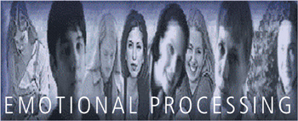
Emotional Processing
“A process whereby emotional disturbances are absorbed and decline to the extent that other experiences and behaviour can proceed without disruption”
“most people successfully process the overwhelming majority of the disturbing events that occur in their lives” Rachman 1980

Slide 27
Grieving
Death of a loved one
Shock, unbelief, overwhelming grief
Acceptance of the reality
Continued grief, tears, sharing with others, thinking about loved one
Funeral
Further grief, life without them, working through issue
Adapting and accepting
Ultimately able to think about person, talk about person,
without strong emotion
Successful emotional processing
“emotional disturbances are absorbed and decline to the extent that other experiences and behaviours can proceed without disruption”

Slide 28
A simple explanation
The Problem; the traumatic memories have been buried and not properly emotionally processed
The Solution; facing the memories allows emotional processing to take place and ultimately removes their emotional power

Slide 29
Before exposure sessions begin:
Explore the patients emotional processing style, using the Emotional Processing Scale
Their family’s style of emotional processing
How they have dealt with the trauma and previous life stresses
Ask what they would have to do to process the traumatic memories?

Slide 30
:
Explore the problems of suppressing emotions
Explore the implications of “opening a can of worms” and prepare for it
Share feelings generally with their partner, family
Read “Emotional Processing; healing through feeling”.
Throughout the whole therapy process discussions revolve around emotions

Slide 31
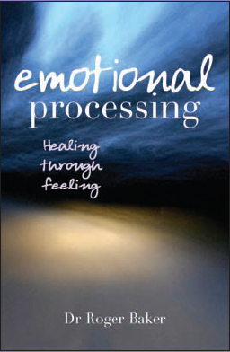

Slide 32

When exposure sessions start:
The patient understands why it is important to face emotional memories

Slide 33

It is part of a ‘lifestyle’ not just a nasty therapeutic procedure

Slide 34
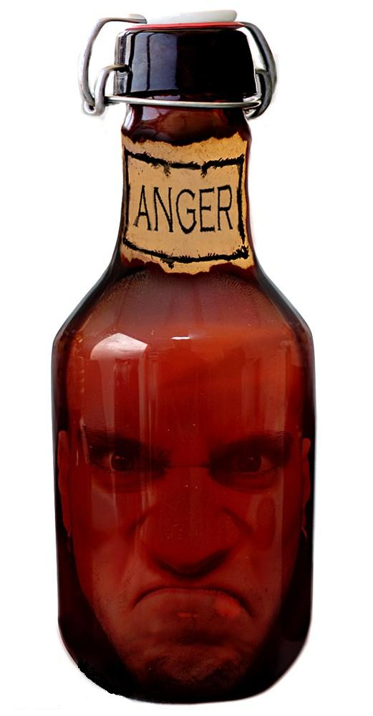
It slots into common cultural beliefs about emotion

Slide 35

It normalises their experience

Slide 36

They have already practised a more open style of sharing feelings

Slide 37
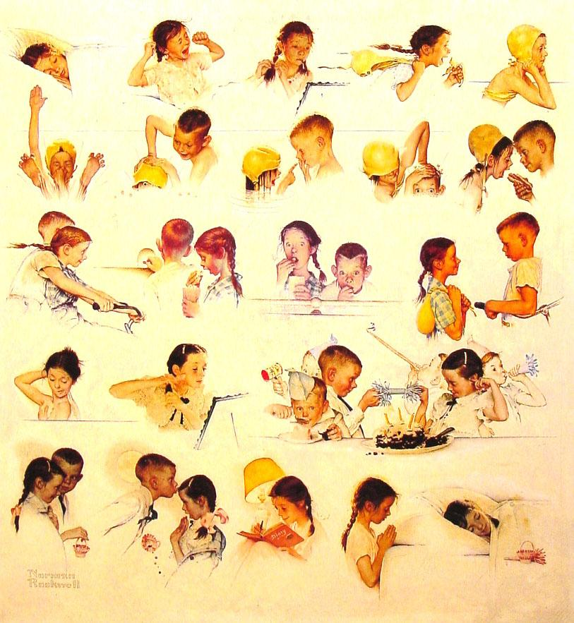
Encourages carry over to everyday life

Slide 38
Case example – Paula
Diagnosed with breast cancer 5 years before
“numb” at diagnosis. Surgeon surprised at her lack of reaction
Surgery,chemotherapy,radiotherapy
Good physical recovery
PTSD diagnosed 5 years after cancer diagnosis

Slide 39
Case example – Paula
“I haven’t begun to deal with it”
Reads “Emotional Processing;healing through feeling”
In discussing her emotional processing style “numbness” started in childhood
Her reaction to unavoidable sexual abuse by family member
Never “processed”

Slide 40
Preparations for Therapy
We discuss importance of talking in detail and the problems which this could cause
Preparations made for reactions to “opening a can of worms”
Where to start? Decision abuse first, cancer later

Slide 41
Emotional Processing of abuse memories
6 sessions discussing details of abuse
Understanding emotional reactions to the abuse and the “rippling effect” it had
Discuss her mother’s death through cancer
Guilt over surviving

Slide 42
Emotional Processing of cancer memories
Session 12 detailed retelling of mammogram, biopsy, cancer diagnosis
Whereas Paula thought she had been emotionally numb she now experienced it emotionally
Further discussions about the future

Slide 43
Complications in treating PTSD in cancer
Multiple traumas
Previous traumas eg.mother’s cancer
Family issues are so common it is difficult to stay focussed on the trauma
Need to formulate sequence of issues to be treated
Need to address physical complications of therapy eg aching limbs, drug side effects
Other psychological sequellae eg.phobias
“Will it return?”

Slide 44
Complications in treating PTSD in cancer
Despite not being as focussed as prolonged exposure for other traumas the overall philosophy of
Sharing
opening up issues
dealing with things
facing hurts
“Emotional Processing Therapy” fits well with the sort of general counselling approach that is needed

Slide 45
Plans for the future
Teach and Mentor other cancer nurses to provide the therapy
Start a PhD project to evaluate Emotional Processing Therapy in cancer

Slide 46



Paperbacks by Roger Baker for purchase

